Slide 1

College of Science, Mathematics and Technology
Reproduce for KeanWISE
Mi Yixuan 1307943

Slide 2
Introduction
Agenda
Methodology
UML Demonstration
Code Running

Slide 3
College of Science, Mathematics and Technology
Introduction
This course selection system reproduced several functions of Kean WISE. It contains two type of users. Student can register and drop different classes; the instructor can check the student’s list of their registered classes. All the user need an account to login.

Slide 4
Methodology
Menu Driven
Encapsulation
Verification
Sustainable

Slide 5
UML Demonstration

Slide 6
UML Demonstration
Student Class
Instructor Class
Course Manager Class

Slide 7
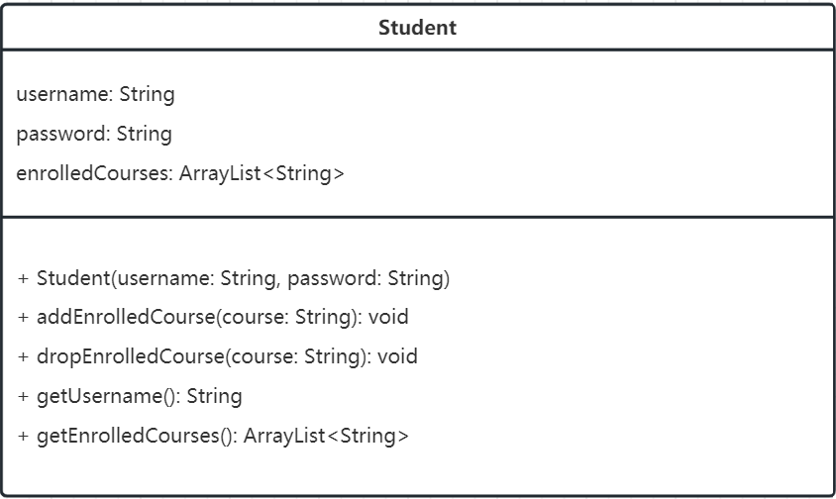

Slide 8
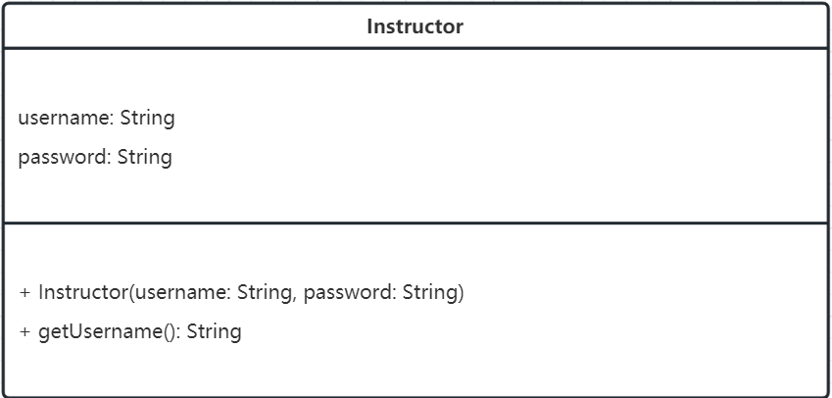

Slide 9
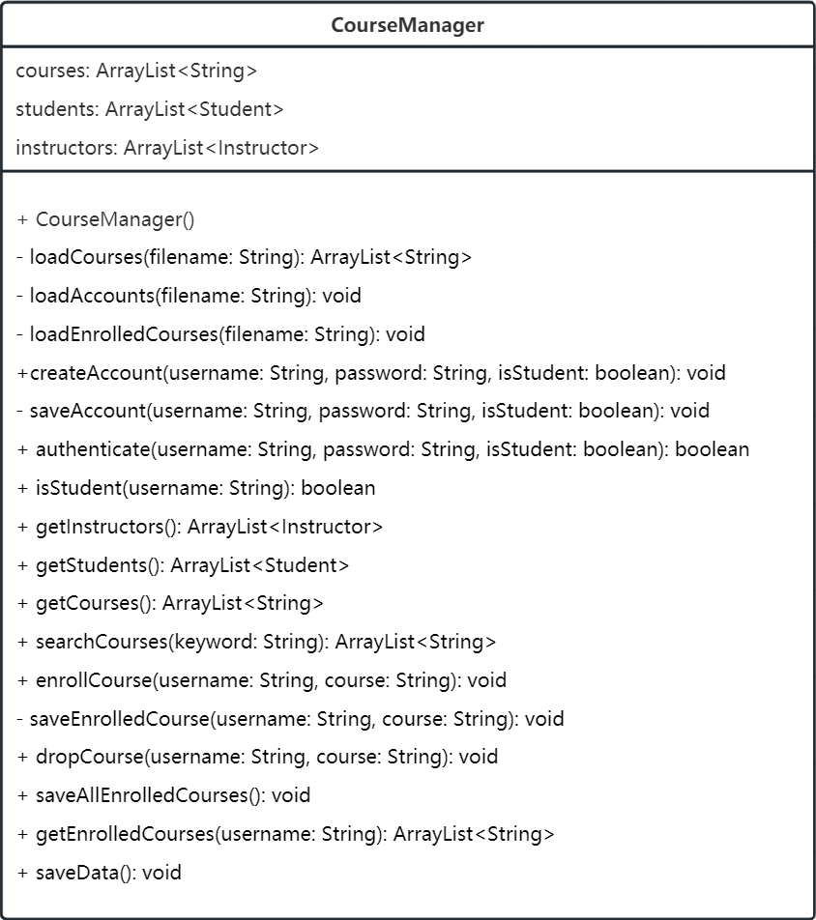

Slide 10
Code Running

Slide 11
Thanks!

